Slide 1



Final Report
- Analysis of influential factors on employment
Team Banana Haeryoung Kim, Ohsang Yoo, Taewoo Kim
Soyeon Kim, Hyeongeun Lee
이 문서는 나눔글꼴로 작성되었습니다. 설치하기
Notes:
Hello, My name is Ohsang Yoo. I am a presenter of Team Banana. Thanks for taking time to see our final report.
As you see, Our project is Analysis of influential factors on employment.

Slide 2
Index
Ⅰ Introduction
Ⅱ About Dataset
Ⅲ Methods
ⅰ) Logistic regression model
ⅱ) Quadratic Discriminant Analysis (QDA)
ⅲ) Classification Tree Analysis
Ⅳ Discussion
Ⅴ Conclusions and Future Directions
Ⅵ References
Notes:
In the next few minutes, I will describe our research and what we should focus when we get a job. Today’s presentation covers 5 themes.
Briefing of the dataset
Methodology and result
Discussion
And conclusion
During this presentation, I intend to cover two things :
First, to explain the relationship between student’s attributes(known as SPEC) and job employment
Secondly, to explain what we have to do

Slide 3

Ⅰ Introduction
Students work hard on their own way
for better job opportunity
Notes:
Now, why should you know this research? If you are not sure, ask yourself this question.
What should I do to get a better job opportunity?
Maybe you’ve never thought about this question before. Or maybe you think about this question all the time. Whichever it is, Everyone need job, and most of us don’t know what we have to do first.

Slide 4

Ⅰ Introduction
‘2013 Graduates Occupational Mobility Survey in Korea' researched by
Korea Employment Information Service
Notes:
With these questions, we found survey data conducted by Korea Employment information Service.
Actually, they gathered so many variables, including GPA score, part time job experience, and even their parents’ occupations. I think this data contains so many private things, but That’s government’s works!

Slide 5
Ⅱ About Dataset
Five Variables
Gender : In Korea, sexual discrimination in employment field is severe.
Age : variable is Korean birth standard.
GPA : students' grades so it is essential source for entering company.
English score : variable is Certified English Test including TOEIC, TOEFL PBT·CBT·IBT, and TEPS which is converted by standard criteria.
Internship Experience : the graduate student who has internship experience.
Notes:
So we chose 5 variables to conduct our research. Look at these variables. We thought these 5 variables are meaningful when we get a job.
Gender : Obviously, South Korea is developed country. But not well developed country. We thought sexual discrimination can occur in employment process.
Age is also important. Most applicants believe that most companies don’t like 30 year old freshmen.
GPA score and English score are well known SPEC in job market.
In addition, we added internship experience.

Slide 6
Ⅲ Methods
1) The logistic regression
2) Classification tree analysis
3) Quadratic Discriminant Analysis
Notes:
Next is How we conduct our research. We conducted our research with these 3 statistical methods.
The logistic regression model is for binary variables. Original simple regression model is not appropriate for binary variables like gender and internship experience.
Classification tree analysis is used to show the final result of our research. I will show prediction of job employment with this model.
Quadratic Discriminant Analysis is also used to find which variable is most affective. And then, we will compare these 3 models in aspect of effectiveness.

Slide 7
Ⅲ Methods
ⅰ) Logistic regression model
Linear correlations between job employment
and all independent variables
Coefficients of each predictor that explains a possibility of the event
Find our analysis was appropriate.
Notes:
As I said Logistic regression model is method for correlations. Look at the following slide

Slide 8
Ⅲ Methods
ⅰ) Logistic regression model
<table.1> Results of logistic regression analysis
Predictors | Estimate Value | P-value
Intercept | 2.0148396 | 0.000392
GENDER | 0.1994438 | 0.020409
AGE | -0.0604207 | 0.000435
GPA | 0.0232155 | 0.805629
ENG_SCORE | -0.0003073 | 0.005259
INTERN_DUMMY | 0.2725206 | 0.001982
Notes:
This is the result of logistic regression analysis. You can find P – values of each variables.
In this figure, Yellow variables mean significant, and the others are not that significant.

Slide 9

Ⅲ Methods
ⅰ) Logistic regression model
‘GENDER’ ‘GPA’
not significant
Stepwise Selection Method
<table.1> Results of logistic regression analysis
Notes:
From this model, we found Gender and GPA scores are not important when we get a job. Therefore, to analyze further, we used ‘Stepwise Selection Method’ for selecting significant variables

Slide 10
Ⅲ Methods
ⅰ) Logistic regression model
table.2> Results of Stepwise Selection Method
Predictors | Estimate Value | P-value
Intercept | 2.1075523 | 0.000000731
GENDER | 0.1961855 | 0.020967
AGE | -0.0606780 | 0.000401
ENG SCORE | -0.0003066 | 0.005353
INTERN DUMMY | 0.2732888 | 0.001912
Notes:
The following table shows the result of Stepwise Selection Method. In this table, P values of Age, Internship is extremely low, so we can conclude that these variables are relatively important.
In addition, misclassification rate of the model after stepwise selection is 0.4118483. This ratio will be used to compare methods each other. The lower ratio, the better method.

Slide 11
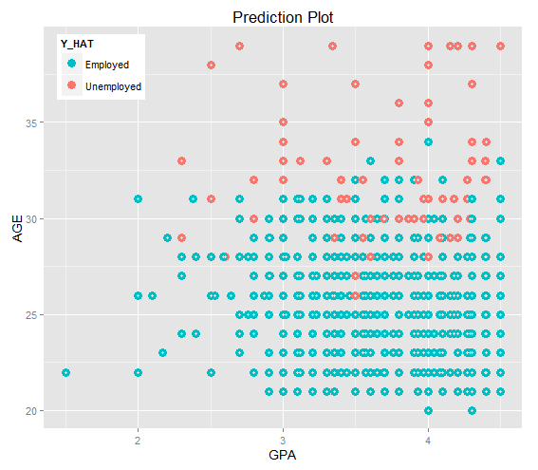
Ⅲ Methods
ⅱ) Quadratic Discriminant Analysis (QDA)
GPA is not influential.
Age is influential under 30.
Misclassification rate
= 0.3507109
Notes:
Quadratic Discriminant Analysis deducting the function classifies groups of employment or unemployment which the cases are corresponded to. If you want further information about this method, google it.
Look at the figure. Blue dot means employed, and red dots are unemployed people.
GPA(x-axis) score is not affective when you get a job. However, age does matter if you are under 30. Misclassification rate of QDA is 0.3507109

Slide 12
Ⅲ Methods
ⅲ) Classification Tree Analysis
Leaves class labels
Branches
conjunctions of features that lead to those class labels.
Process
If the figure gets true value, go left and if it is false, go right.
Notes:
Classification Tree Analysis is used when the predicted outcome is the class which the data belongs to.
In tree structures, leaves represent class labels and branches represent conjunctions of features that lead to those class labels.

Slide 13
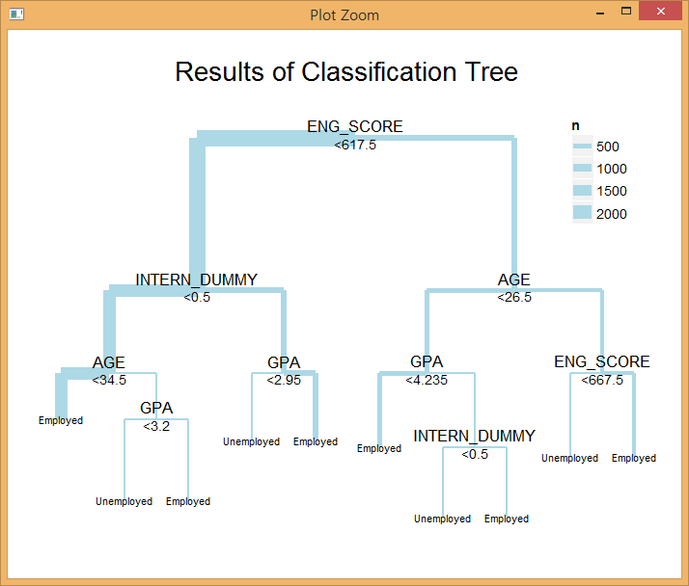
Ⅲ Methods
ⅲ) Classification Tree Analysis
‘English SCOre’, ‘AGE’, ‘GPA’
‘Internship experience are used
Terminal code is 5
Misclassification rate
= 0.3464455
Notes:
The result of the visualization is as right above. Interpretation the results of Classification tree analysis are very intuitive.
With comparing the value corresponding to each independent variable, we proceed step by step.
If the figure gets true value, go left and if it is false, go right. Misclassification rate from Classification Tree is 0.3464455.

Slide 14
Ⅳ Discussion
misclassification ratio
41.1%, 35.1%, 34.6%
the most suitable model
to predict employment
= Classification Tree
Notes:
The results of misclassification ratio are 41.1%, 35.1%, and 34.6%.
Among them the lowest value of misclassification ratio model is classification tree so that we judge it the most suitable model to predict employment.

Slide 15

Ⅳ Discussion
Judging from classification tree
English score is essential factor
Other variables also can be important
For most graduates
getting more than some degree of GPA is crucial
Notes:
So I’ll interpret the results of classification tree
English score is essential factor distinguishing whether graduates get employed.
Other variables (Internship experience, age, and GPA) also can be important.
We conclude that for most graduates having low English score and having no internship experience, getting more than some degree of GPA is crucial.

Slide 16
Ⅴ Conclusions and Future Directions
Classification Tree model is appropriate
GPA score is meaningful
English capacity and Internship experience are important
Graduates, who are looking for a job, should focus on not only getting high GPA but also acquiring or improving their
general capability
Notes:
Most finally I’ll conclude all of our results above briefly.
The Classification Tree model is appropriate for the research and GPA scores are meaningful when we get a job
English capacity and internship experience are important.
This result demonstrates we should try hard to get ready for practical ability also.
So we suggest, graduates including us who are looking for a job, should focus on not only getting high GPA but also improving general capability.
These are what our team have prepared.
Thank you for listening.

Slide 17
Ⅵ References
“Conversion Table of Seoul University TEPS Governing Committee” from TOEIC, TOEFL PBT·CBT·IBT, TEPS. (http://www.teps.or.kr/Teps/Public/conversiontable.aspx)
- Korea Employment Information Service http://survey.keis.or.kr
- Job Korea. http://www.freedomsquare.co.kr/1561
- National Statistical Office ‘ Korea Standard Certification Occupation(KSCO, following 6th reform)

Slide 18
Thank YOU

